Slide 1
Machine Learning and Analytics Material Science - Analysis of Dataset
Group Members
Danish Amin - EE17BTECH11013
Nikhil Sachan - MS17BTECH11011
Pradyumna Kabra - MS17BTECH11015
Adarsh Bujade - MS17BTECH11002

Slide 2
Dataset Source
We have collected this dataset from this site
https://archive.ics.uci.edu/ml/datasets/superconductivty+data
The data has been primarily collected by Kam Ham idieh (khamidieh '@' gmail.com), University of Pennsylvania, Statistics.
He also has a paper in which he has used this dataset for statistical analysis and also for Machine Learning applications.
This is the paper: https://www.sciencedirect.com/science/article/abs/pii/S0927025618304877?via%3Dihub

Slide 3
Motivation
In the absence of any theory-based prediction models, the only best approach to estimate the critical temperature is to perform experiments and conclude the results for the same.
Here we have taken the statistical approach to overcome the issue as explained above. We shall be using Machine Learning approach to estimate the critical temperature of the material based on the chemical composition and physical properties.
This dataset is of superconductor materials where the type of material is Oxide and Metallic. The motivation here is to predict the critical temperature of the material based on the chemical composition and physical properties such as mean atomic weight and mean atomic radius and other parameters.

Slide 4
Dataset Analysis-Feature Extraction
The data we have collected has already features extracted from it. But it won’t be a good analysis if we didn’t show the process of feature extraction.
So first the material is picked, let’s say Re₇Zr₁
We first gets it proportions, p₁ = 6/7 and p₂ = 1/7
Then we get proportion of thermal conductivity(used as an example) t₁ = 48/71 and t₂ = 23/71
And finally some intermediate value A = p₁w₁/(p₁w₁ + p₂w₂) and B = p₂w₂/(p₁w₁ + p₂w₂)
Now we can have 10 feature for each property of material.

Slide 5
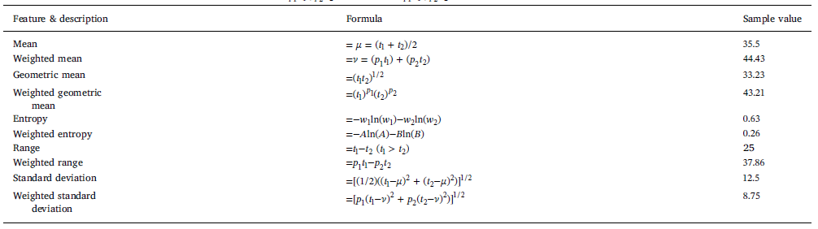
Dataset Analysis-Feature Extraction

Slide 6
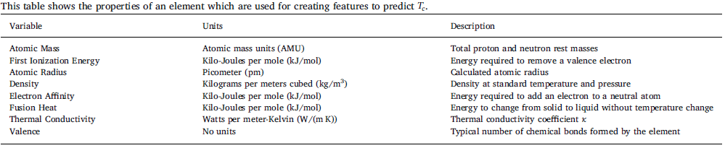
Dataset Analysis-Feature Extraction

Slide 7
Dataset Analysis-Feature Extraction
After doing this on all the Properties we have 80 features and we also included one more feature that is number of atoms in the material, thus making it total of 81 features.
We also have a data which tells the proportion of each element a particular material has but this data is not included in features because we already have so many features and our prediction model might start to overfit if a lot of parameters are there.

Slide 8
Dataset Analysis-Correlation Heatmap
For the first Dataset containing feature below is the correlation Heatmap for only mean features of the properties.
For the second Dataset containing element proportion below is the heatmap for only 10 element having most high mean temperature.

Slide 9
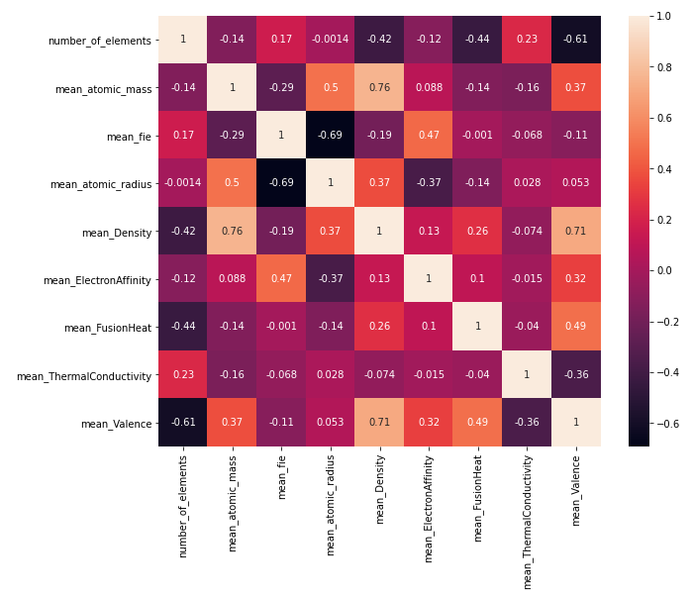
Dataset Analysis-Correlation Heatmap

Slide 10
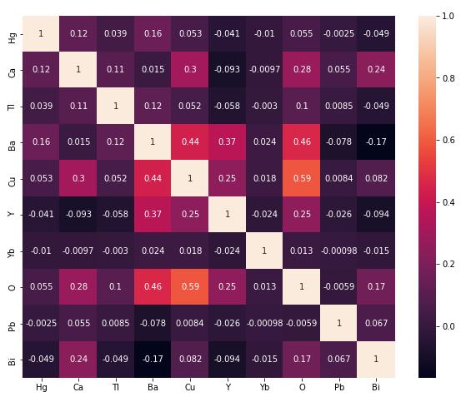
Dataset Analysis-Correlation Heatmap

Slide 11
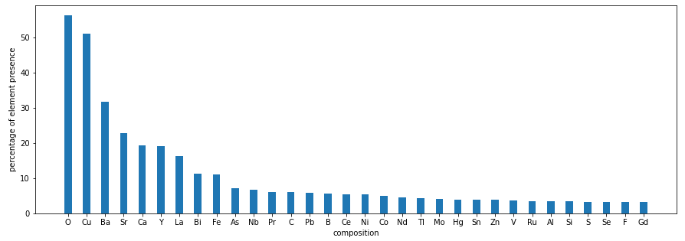
Dataset Analysis-Element Presence Bar Chart
Here is the bar chart of element occurring the most in all the material we have in our dataset.

Slide 12
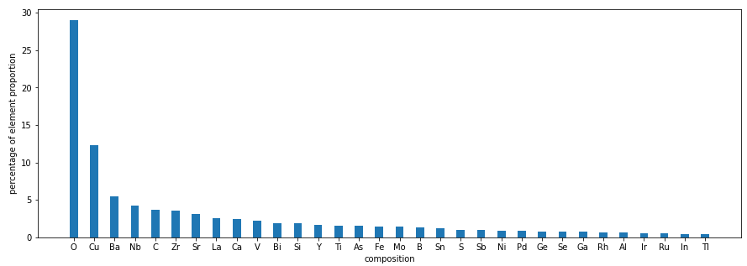
Dataset Analysis-Element Proportion Bar Chart

Slide 13
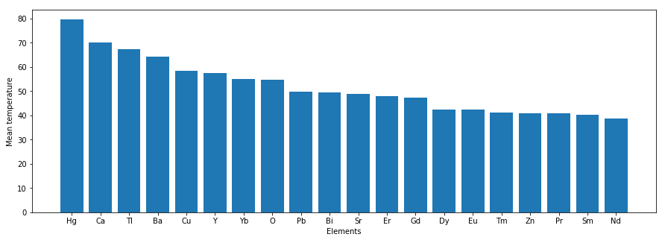
Dataset Analysis-Element Mean Temp. Bar Chart

Slide 14
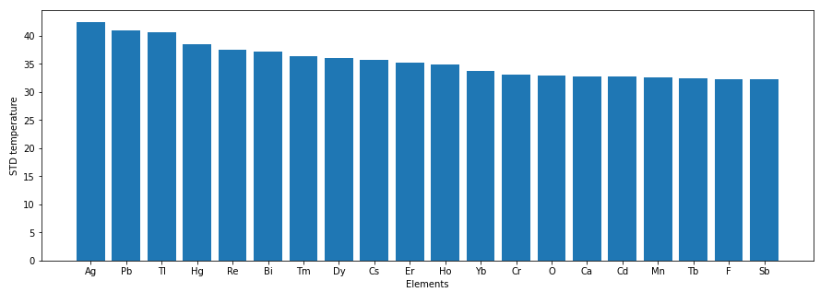
Dataset Analysis-Element STD Temp. Bar Chart

Slide 15
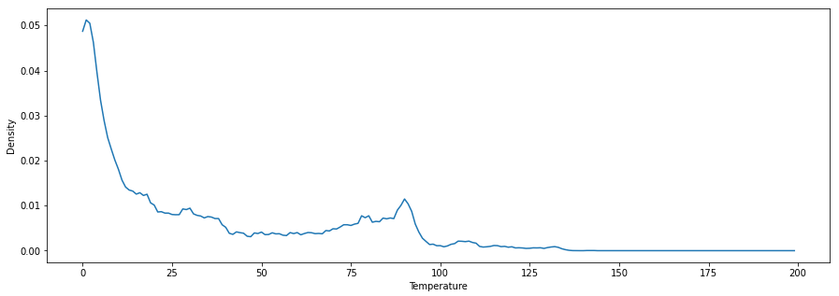
Dataset Analysis-Temp. Density Graph

Slide 16
Dataset Analysis-Conclusion
Oxygen is present in about 56% of the superconductors. Copper, barium, strontium, and calcium are the next most abundant elements.
Iron is present in approximately 11% of the superconductors. The mean T_{c} of superconductors with iron is 26.9 ± 21.4 K.
The non-iron containing superconductors’ mean is 35.4 ± 35.4 K.
Density graph is Bimodal and values are right skewed with a bump around 80 K.
Mercury containing superconductors have the highest Tc at around 80 K on average.
Mercury also has 4th largest standard deviation, falling behind Ag, Pb and Ti.

